Slide 1
Petroli Your Fueling Solution
Feras Samkari - 2240371.
Yaser Alwuayl – 2243535.
Mohammed Abdu – 2241473.
Abdulsalam Ahyaf – 2242187.
Abdulmajeed Abdullah – 2240297.

Slide 2
Table of contents (1 of 2)
01
02
03
Project Overview
Business Case
Stakeholder Register
04
05
06
Project Charter
Kick-off Meeting
Scope Statement

Slide 3
Table of contents (2 of 2)
07
08
09
Work Breakdown Structure (WBS)
Gantt Chart
Network Diagram
10
11
12
Activity Cost Estimation
Executive Level Report
Conclusion

Slide 4
01
Project Overview

Slide 5
What are our Project Overview?
overview
Budget
project dates
Petroli aims to develop a mobile application to help users locate nearby gas stations and facilitate fuel delivery services.
375,000 SR
(56,250 SR for upkeep)
Start Date: 13/05/2024,
Finish Date: 23/06/2025

Slide 6
Business Case
02

Slide 7
Business Case Overview
Objective
Problem Statement
Options
Develop an application to assist users in finding the nearest gas station
Address the challenge faced by drivers when they need to find a gas station or when their vehicles run out of fuel.
No action
2) Purchase additional equipment and software
3) Utilize existing resources.

Slide 8
Project Requirements and Financial Analysis
Financial Projections
Schedule
Potential Risks
NPV of $165,500, ROI of 105% over three years, and payback in one year.
Completion in seven months with a system lifespan of at least five years.
User difficulties with the payment process and potential technological challenges.

Slide 9
03
Stakeholder Register

Slide 10
Stakeholder
Abdulsalam Mohammed
Abdulmajed Abdullah
Feras Samkari
Mohammed Abdu
Yaser Alwuayl
(Project Manager)
Level of Interest: High
Level of Influence: High
(Project Sponsor)
Level of Interest: High
Level of Influence: High
(Advisor)
Level of Interest: Low
Level of Influence: High
(Visual Designer)
Level of Interest: High
Level of Influence: High
(Developer)
Level of Interest: Low
Level of Influence: Low

Slide 11
Project Charter
04

Slide 12
Project Charter Infographics
Project title | Petroli
Start date | May 13, 2024 | End date | June 23, 2025
Budget to complete this project is
375,000‎ ‎ ‎ ‎ ‎
Objectives | - Simplify locating gas stations for drivers. - Enhance convenience and safety with real-time information.
SR
Success Criteria
Pay for itself within one year.
Complete within seven months with a 375,000 SR budget.
Approach
Customized questionnaire for user needs.
Learn from past mistakes and adapt project accordingly.
Prioritize user-friendliness and robust security.

Slide 13
05
Kick-off Meeting

Slide 14
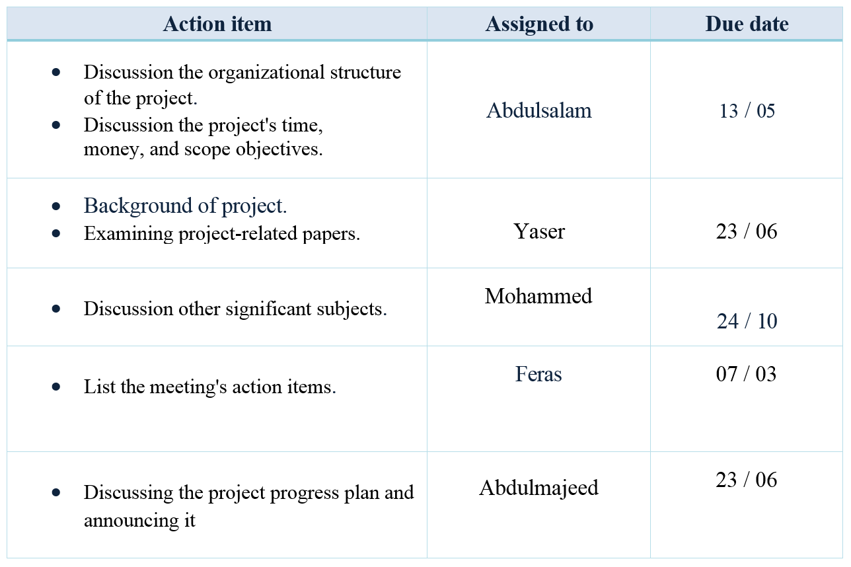
Kick-off Meeting Overview
Meeting Objective:
Introduce key players, state project objectives, discuss future aims, and explore strategies for success.
Provide details about the project budget.

Slide 15

Scope Statement
06

Slide 16
Scope Statement
Justification
Budget and Success Criteria
“Petroli” app to simplify locating gas stations for Jeddah and other communities.
1
2
375,000 SR project budget with 56,250 SR annual maintenance. Expected annual benefits of 900,000 SR.
Deliverables
Key Features
4
3
Charter, WBS, schedule,
lessons-learned report,
testing and deployment plan,
and more...
Fuel station locator,
fuel delivery request,
push notifications.

Slide 17
07
Work Breakdown Structure (WBS)

Slide 18
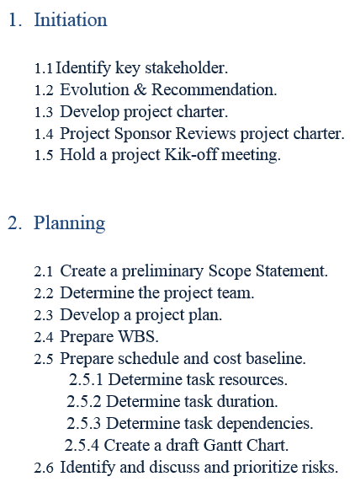
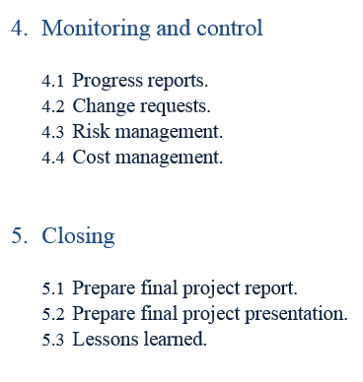
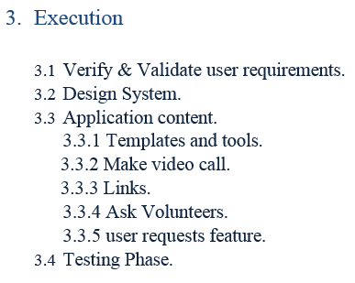
Work Breakdown Structure (WBS)

Slide 19
Gantt Chart
08

Slide 20
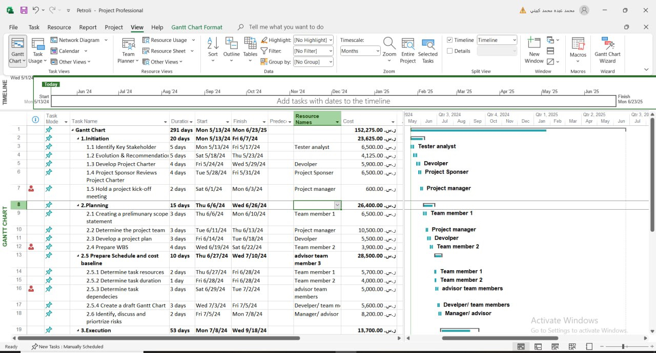
Gantt Chart (1 of 2)

Slide 21
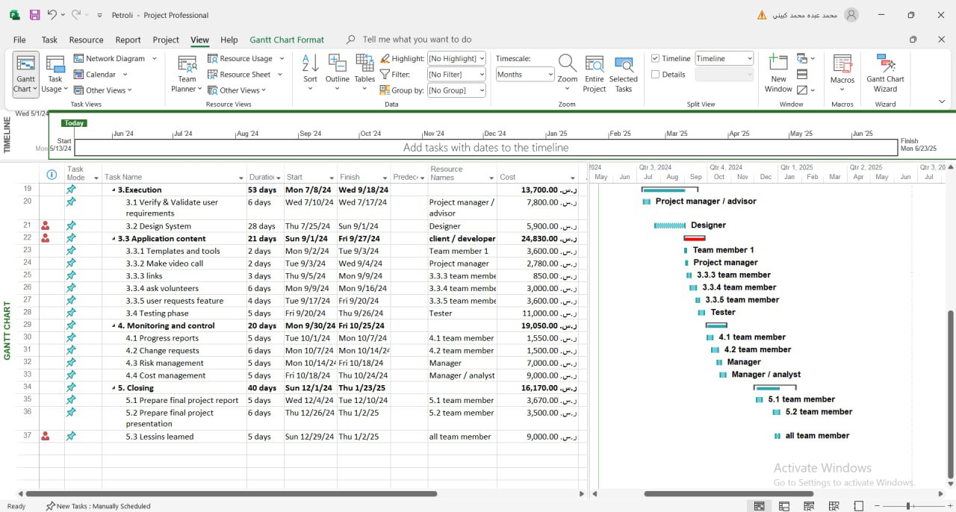
Gantt Chart (2 of 2)

Slide 22
09
Network Diagram

Slide 23
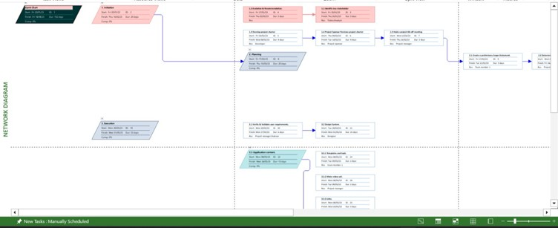
Network Diagram

Slide 24
Activity Cost Estimation
10

Slide 25
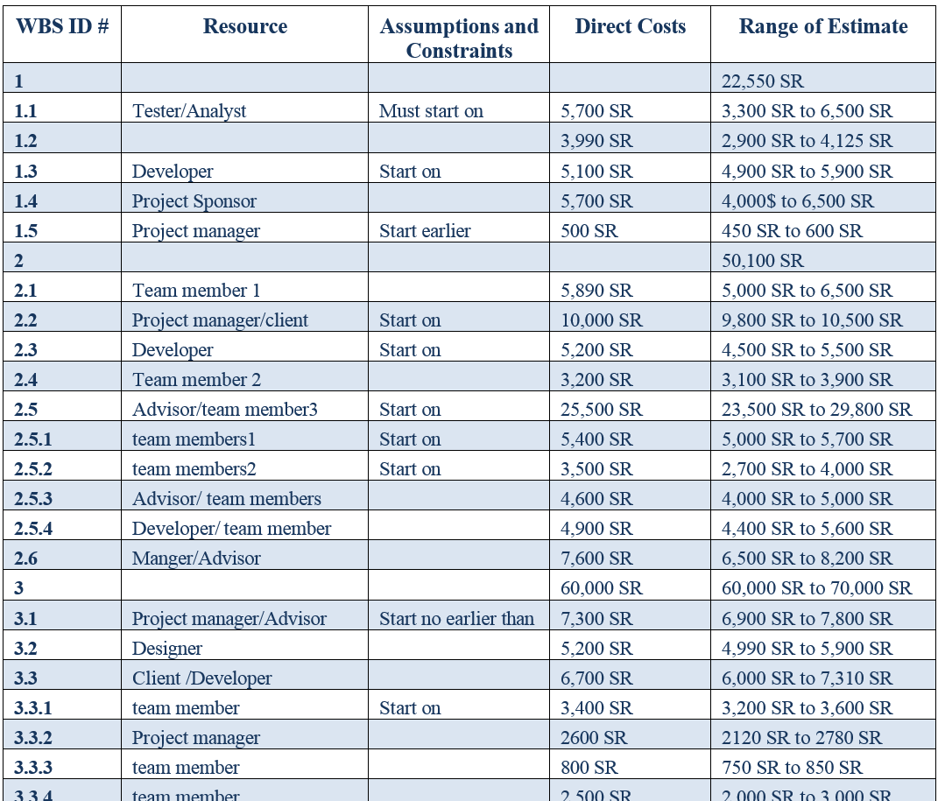
Some of the Activity Cost

Slide 26
11
Executive Level Report

Slide 27
Executive Level Report
01
02
03
Achievement of Objectives
Performance Standards
Fulfillment of Requirements
04
05
06
Project Management Lessons
Successful Aspects
Project-Related Error
It contain these Key Points:

Slide 28
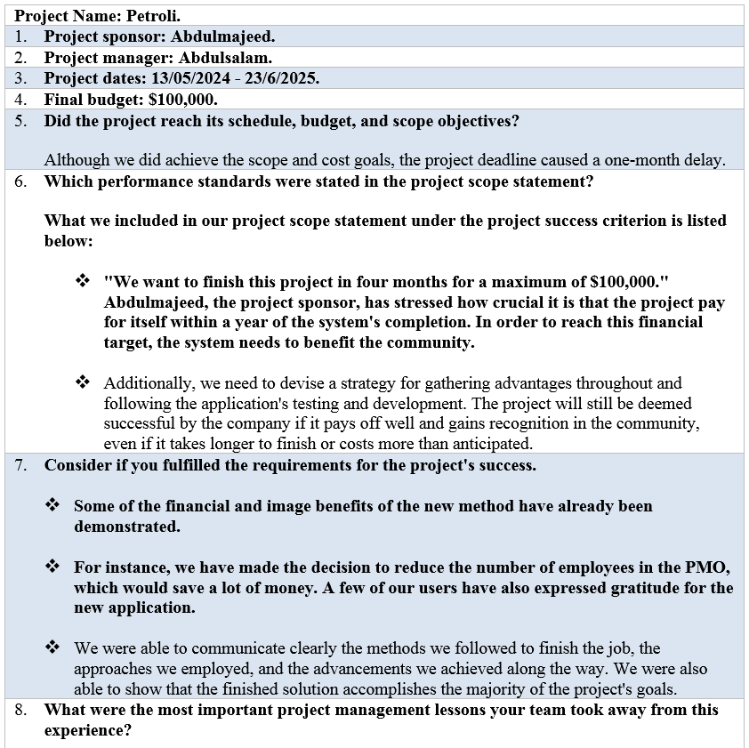
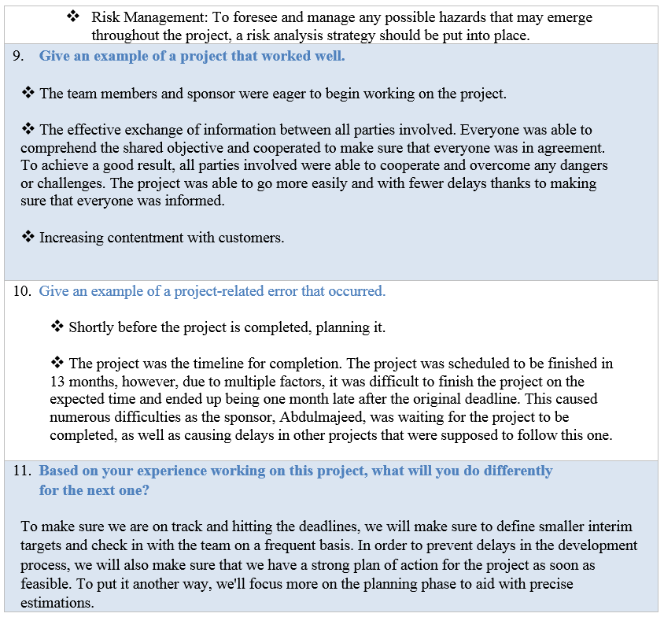
Picture of Executive Level Report

Slide 29
Conclusion
12

Slide 30
Conclusion
The Petroli project stands as a testament to effective project management and teamwork, demonstrating the ability to overcome challenges and deliver impactful results. As we reflect on the journey of the Petroli project, we are poised to apply these learnings and insights to future projects, driving continued success and innovation.

Slide 31
Thanks!
Do you have any questions?
Presented by:
Abdulsalam Ahyaf
Abdulmajeed Abdullah
Feras Samkari
Mohammed Abdu
Yaser Alwuayl

